Slide 1


20-03-25
Hopfield model
Group 1
Chiara Tramarin Antonio Donà
Alessio Tuscano Alberto Schiavinato

Slide 2






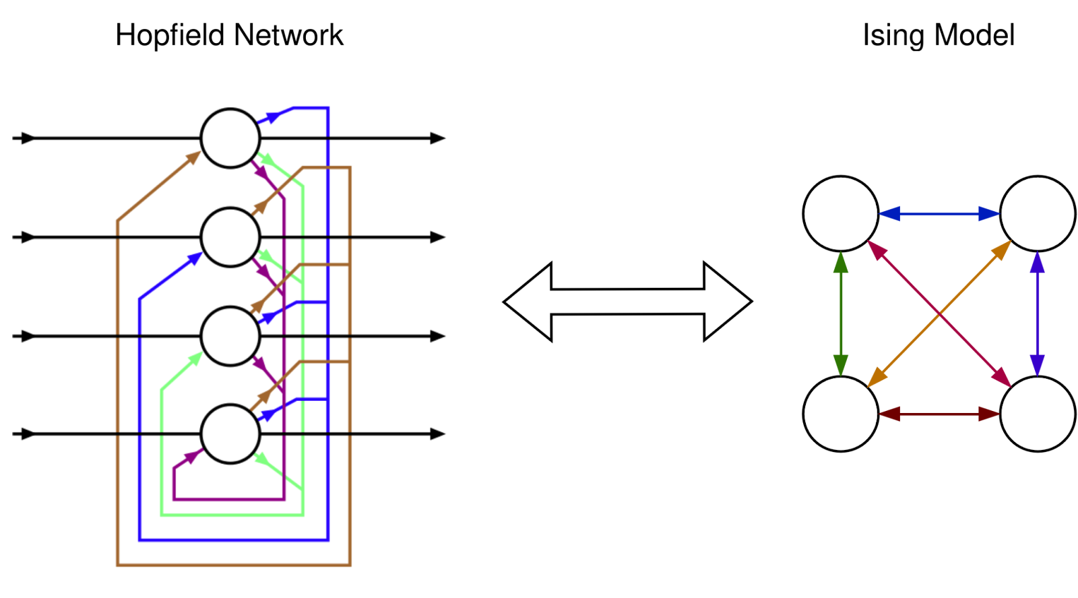
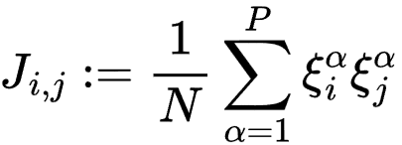

Introduction
Pattern set
(random sequences, images, etc.)
. . .
P patterns over N! possible sequences
1
Train model
Corrupt pattern
2
Flatten
Reshape
Restore
3
Notes:
A Hopfield network is a type of neural network commonly used for pattern recognition in which all nodes are fully connected. In this notebook, the Hopfield net is evaluated based on its capacity to recall patterns using either the Hebbian or Storkey learning rules

Slide 3
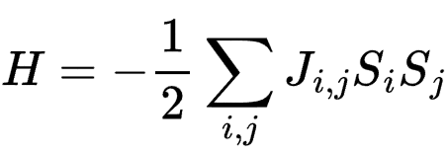
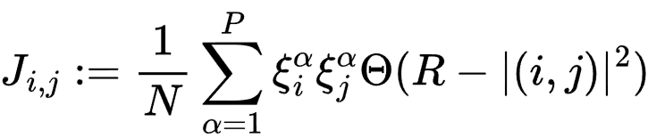
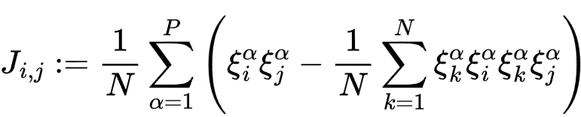
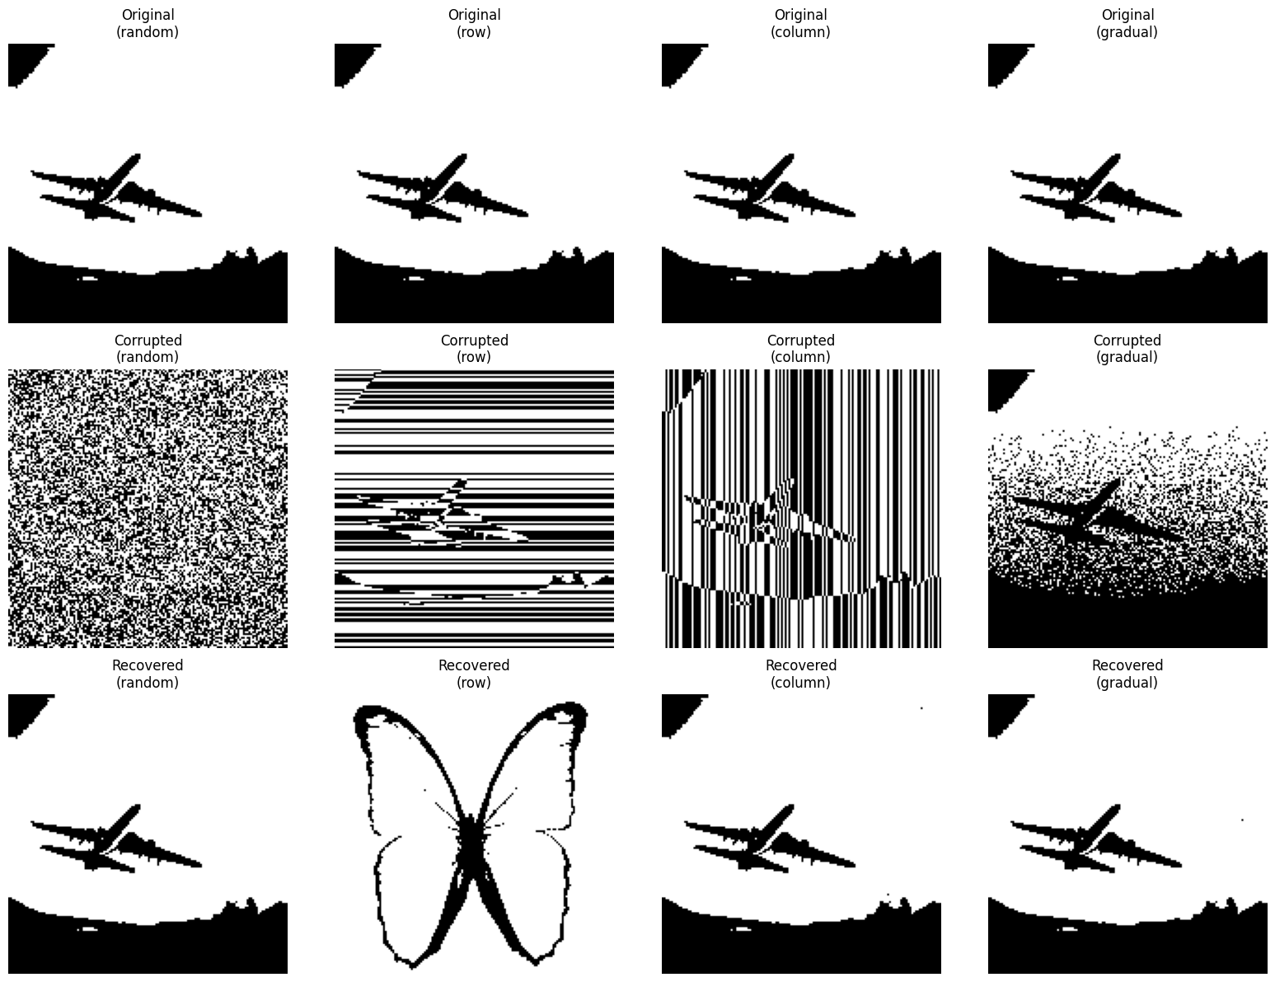
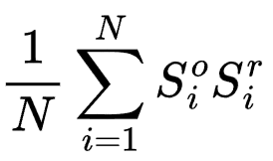
Overview of the model
1
Hebb’s rule
Training the model
Energy definition:
Coupling matrix definitions
Local coupling
Storkey’s rule
2
Corrupt patterns
3
Restore data
Different error correction algorithms to minimize H:
Asynchronous sign rule
Synchronous sign rule
Monte Carlo sampling with Metropolis Algorithm
+
Check overlap for convergence:
Notes:
COME FUNZIONA L’ALGORITMO ?, FOTO IN BOH NON SO CHE RISOLUZIONE, PENSO SIANO SCREEN MA NON RICORDO DA DOVE LE HO TIRATE FUORI
CREAZIONE DI P PATTERN DI LUNGHEZZA N 1 o 2d, noi abbiamo usato 2d per better visualization)
CORRUZIONE DEI PATTERN, FLIPPANDO CON UNA CERTA PROBABILITà
RICOSTRUZIONE PATTER: CALCOLO MATRICE J E REGOLA DI AGGIORNAMENTO ( FORMULE J E S) BASICHE
->OVERLAP CHE MI DICE QUANTO RICOSTRUISCE BENE

Slide 4
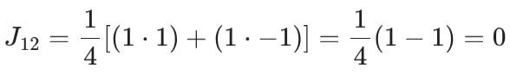
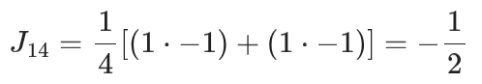
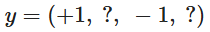
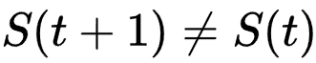
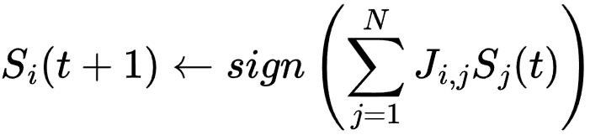
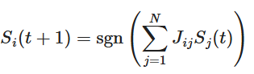
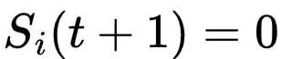
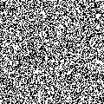
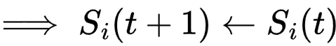
An example
Initialize the model based on pattern set
Corrupt a pattern with
independent random noise
While :
Update the state:
If
Break loop if max number
of steps is reached
Check the overlap between
original and recovered state
Notes:
COME LO FA QUINDI ? AGGIORNA UNO PER UNO I PIXEL FINO A CONVERGERE AD UN MINIMO DI ENERGIA, COME NEL MODELLO DI ISING
LO VEDIAMO CON UNA GIF:

Slide 5
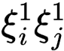
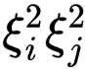
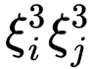
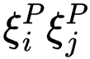
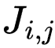
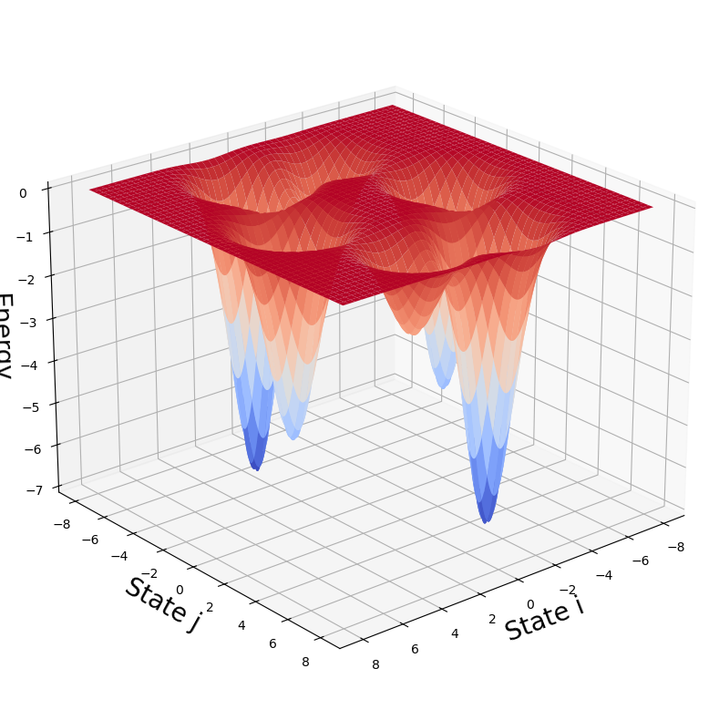
Model training
+
+
… +
=
Spurious state
Energy minima (patterns)
Notes:
Ricostruzione immagini 2d con pattern random, qui foto da cambiare
QUINDI IL MODELLO FUNZIONA( ALMENO IN QUESTO CASO, MA QUANTO BENE ? ) GIA CON LE IMMAGINI ABBIAMO I NOSTRI PRIMI PROBLEMI …

Slide 6
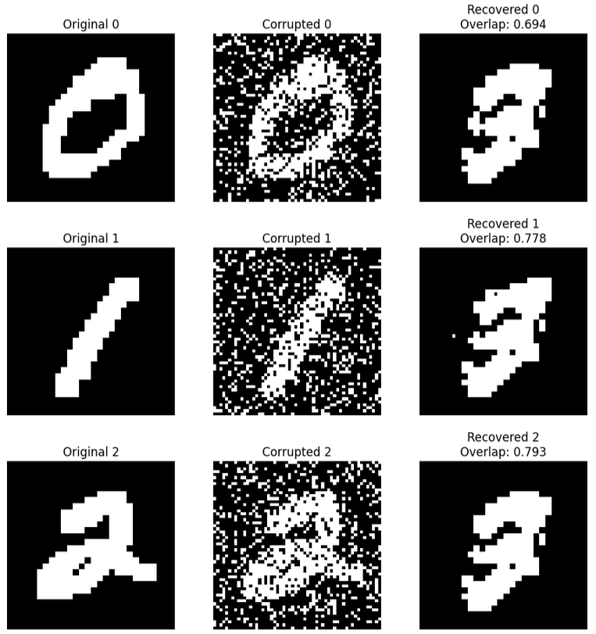
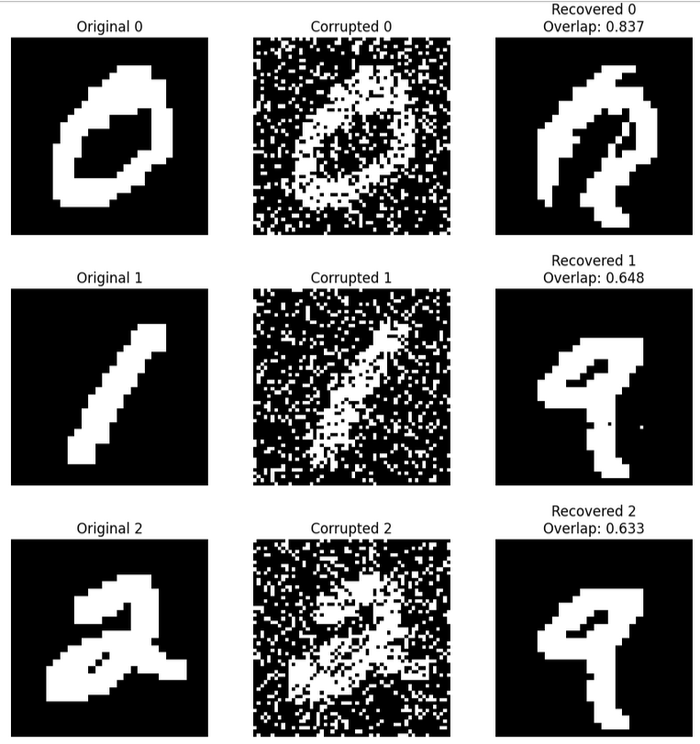
Model limitations
Capacity
Interference
Strong minima / Spurious minima
Notes:
FOTO IN BOH NON SO CHE RISOLUZIONE, PENSO SIANO SCREEN MA NON RICORDO DA DOVE LE HO TIRATE FUORI
Sincrona: prodotto tra lo stato e tutta la matrice del pattern
Asincrona: sampla un neurone

Slide 7
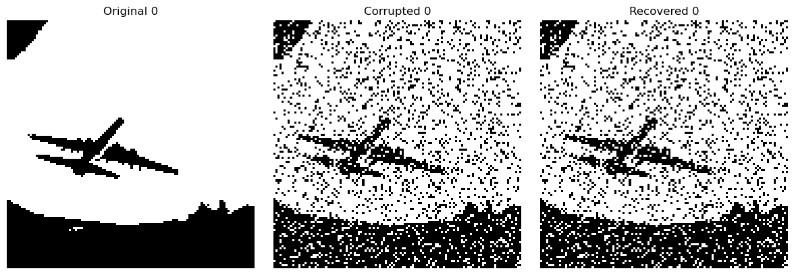
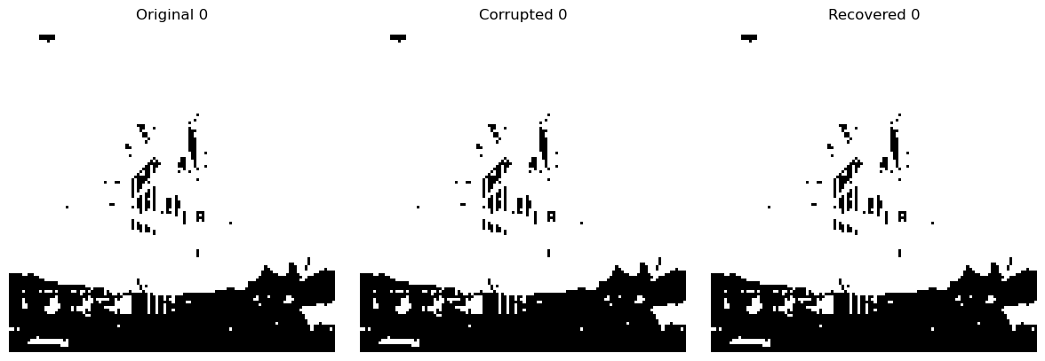
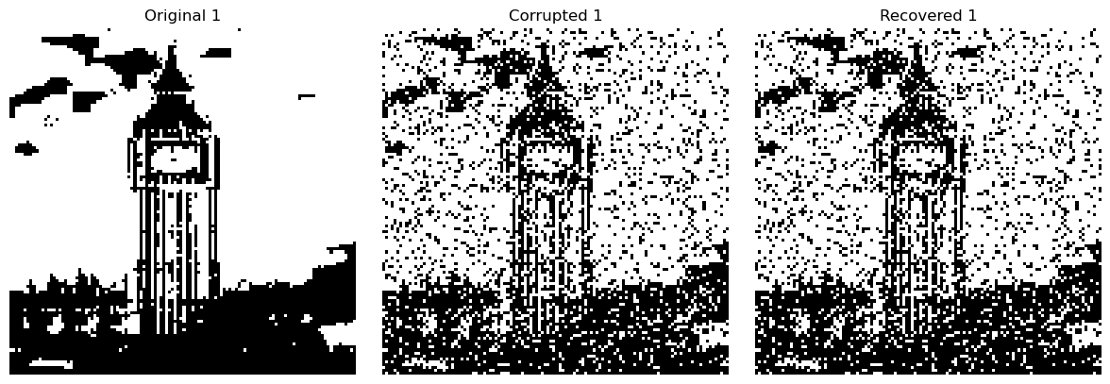
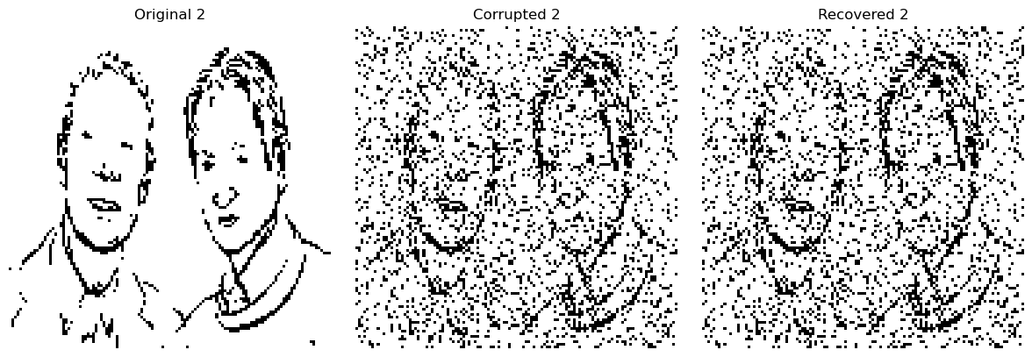
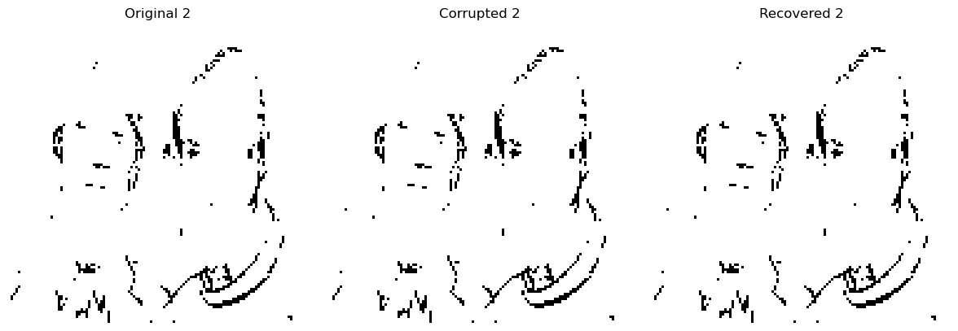
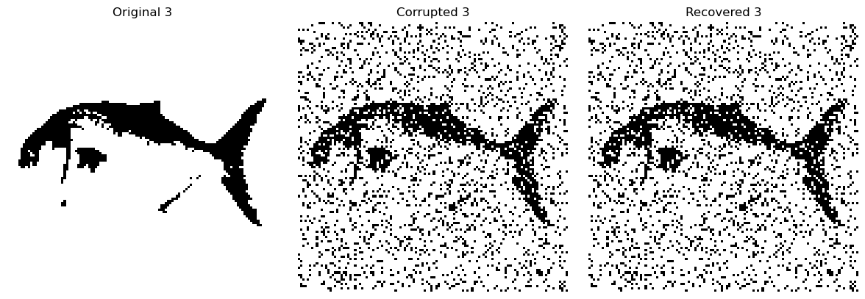
Training: Hebb’s rule
Original Corrupted Recovered (SR) Recovered (MC)
Fast execution
Uncorrelated couplings
Best suited for random patterns
4 patterns, 120x120px,
random corruption with q=0.85
Notes:
Ricostruzione immagini 2d , FOTO IN BOH NON SO CHE RISOLUZIONE, PENSO SIANO SCREEN MA NON RICORDO DA DOVE LE HO TIRATE FUORI
Qui foto da cambiare
CON LE IMMAGINI NON VA, METTO IMMAGINI RICOSTRUIRE CON HEBB CHE NON VENGONO

Slide 8
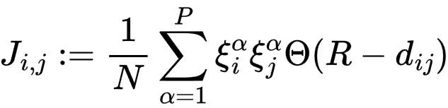
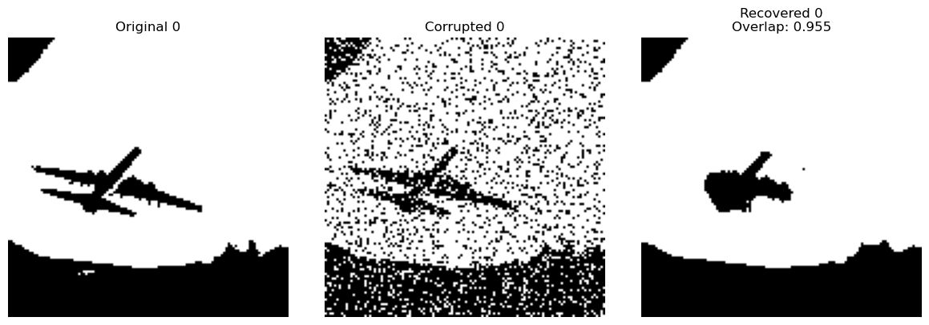
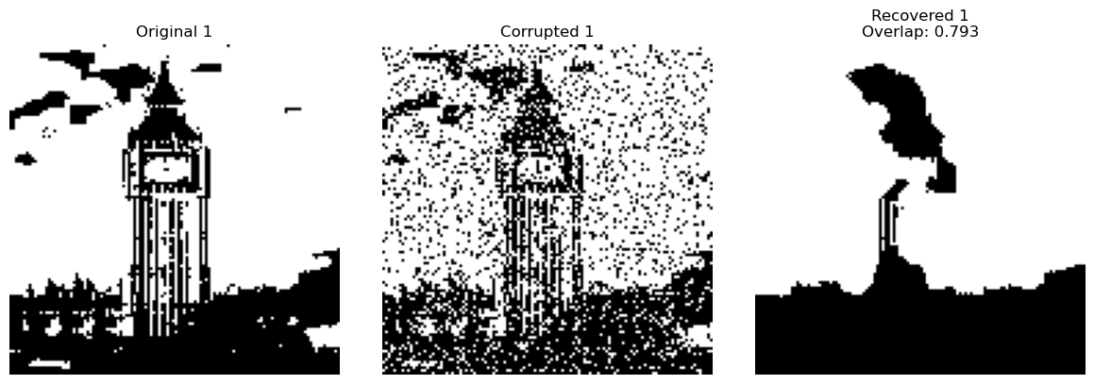
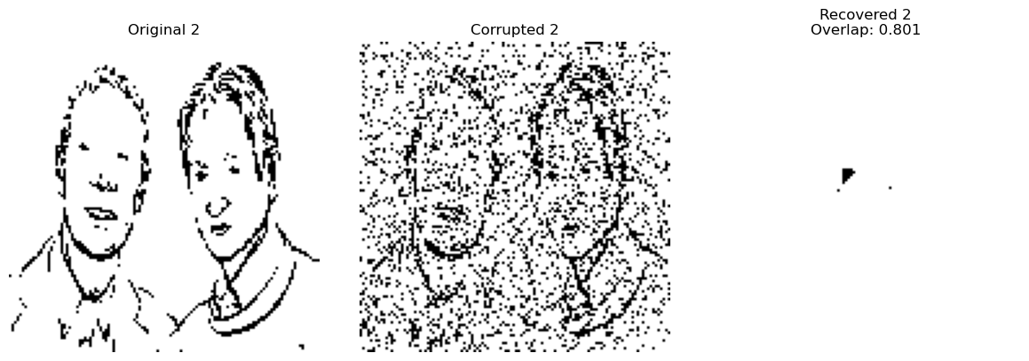
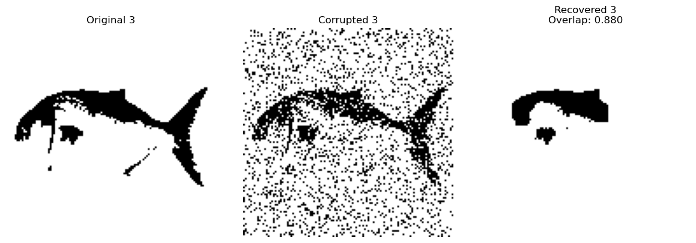
Training: Local rule
Original Corrupted Recovered (SR)
Faster execution
Discards couplings between points distant more than R
Better results for correlated patterns
4 patterns, 120x120px,
random corruption with q=0.85,
R=4
Notes:
DIVERSE REGOLE DI AGGIORNAAMENTO S E PER J MATRICE DI CORRELAZIONE
FORMULE DI
HEBB VS TURKEY VS LOCAL
FORMULE DEL SEGNO ( sincrona e asincrona ) VS MONTECARLO ( formula montecarlo)
->ABBIAMO LA PRESENZA DI MINIMI SPURI

Slide 9
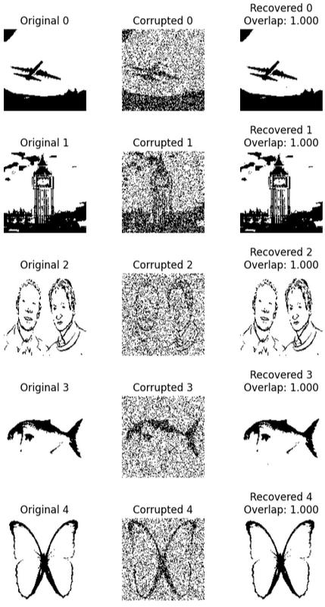
Training: Storkey rule
Sensibly more computationally demanding
Greatly reduces interference, however does not completely remove spurious states
Best solver for correlated patterns
5 patterns, 120x120px,
random corruption with q=0.75,
T=1e-3, alpha=1e-5, logarithmic schedule
Notes:
( SE USO LA GIUSTA RISOLUZIONE…)(80X80) VS (120X120), SETTANDO SEMPRE I GIUSTI PARAMETRI... -> abbiamo quindi deciso DI FARE UNO STUDIO PIU SISTEMATICO DI QUESTE REGOLE
Per vedere quanto funziona il modello con i due dataset piu basici, facendo una grid search-> mnsit e random

Slide 10
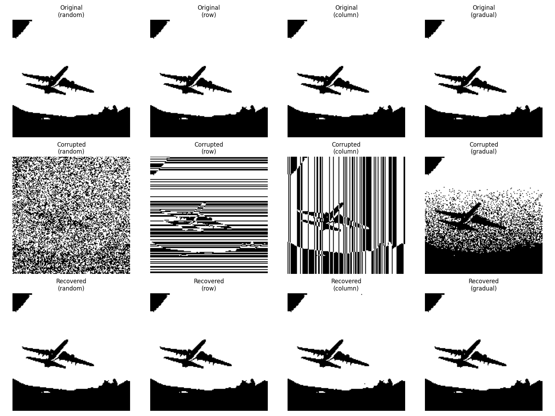
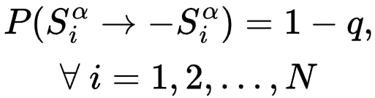
Different Corruptions
Notes:
FOTO IN BOH NON SO CHE RISOLUZIONE, PENSO SIANO SCREEN MA NON RICORDO DA DOVE LE HO TIRATE FUORI

Slide 11
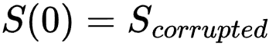
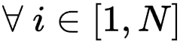
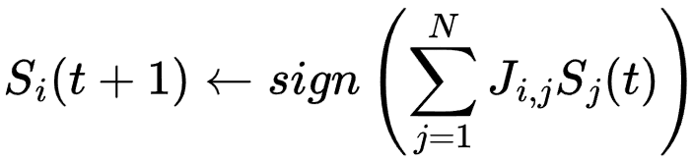
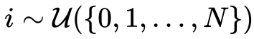
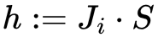
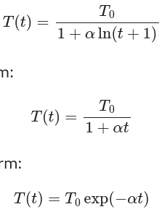
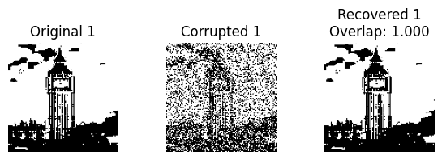
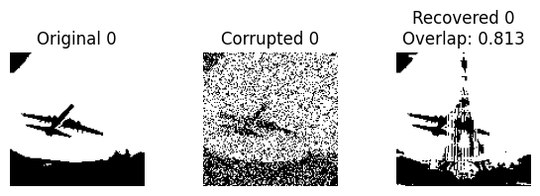
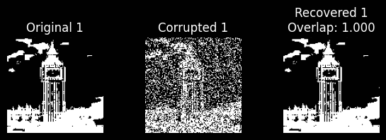
Different update algorithms
Synchronous
Asynchronous
Monte Carlo , but
only if
Sign rule
Different index sampling methods
MC Schedules
Converge when pattern stays constant for an arbitrary number of iterations
-1.000
Original state / inverted
Spurious state
Notes:
FOTO IN BOH NON SO CHE RISOLUZIONE, PENSO SIANO SCREEN MA NON RICORDO DA DOVE LE HO TIRATE FUORI
Sincrona: prodotto tra lo stato e tutta la matrice del pattern
Asincrona: sampla un neurone

Slide 12
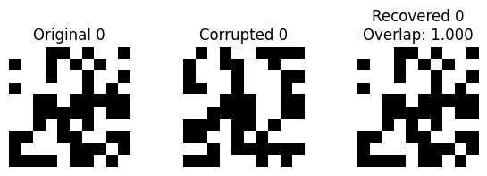
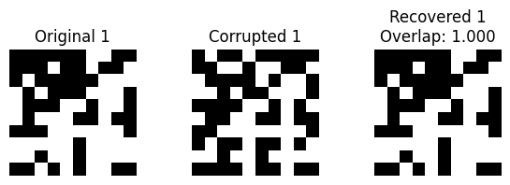
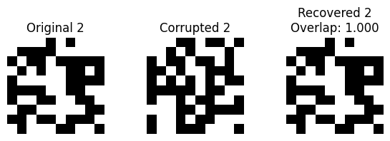

2D Random VS Images
Update Metohd : Synchronous
Learning Rule : Hebb
q : 0.7
Very High Overlap
Notes:
We observe that the network has much more difficulty recovering images compared to random patterns. This is because real images have structured correlations—neighboring pixels are often similar—whereas random patterns are uncorrelated. As a result, the stored images tend to interfere with each other more, making retrieval less accurate. Additionally, since images contain repetitive features and large uniform regions, the network is more likely to fall into spurious minima, struggling to reconstruct the correct pattern.

Slide 13




2D Random VS Images
Notes:
SCREE, FOTO IN BASSA DIMENSIONE

Slide 14
2D Random VS Images
Update Metohd : Synchronous
Learning Rule : Hebb
q : 0.75
Still high overlap, but not so good..
Why?
Notes:
SCREE, FOTO IN BASSA DIMENSIONE

Slide 15
Hyperparameters Overview
q
N. patterns
T (temperature)
Hopfield Model
Monte Carlo
Alpha (learning rate)
Dimension
Synchronous
Classic schedule
Update method
Asynchronous
Exp. schedule
Log. schedule
Learning rule
Hebb’s
Local
R (radius)
Varying parameters
Storkey’s
Active Pars
Inactive Pars
Notes:
SCREE, FOTO IN BASSA DIMENSIONE

Slide 16
Hyperparameters q,P
q
N. patterns
T (temperature)
Hopfield Model
Monte Carlo
Alpha (learning rate)
Dimension
Synchronous
Classic schedule
Update method
Asynchronous
Exp. schedule
Log. schedule
Learning rule
Hebb’s
Local
R (radius)
Varying parameters
Storkey’s
Active Pars
Inactive Pars
Notes:
SCREE, FOTO IN BASSA DIMENSIONE

Slide 17

Capacity varying q, P
Theoretical limit
Notes:
Foto in alta dimesione

Slide 18


Capacity varying q, P
Notes:
Foto in alta dimensione
df = pd.read_csv("grid_search_results/grid_search_results_q_n_patterns.csv")

Slide 19
Hyperparameters N, P
q
N. patterns
T (temperature)
Hopfield Model
Monte Carlo
Alpha (learning rate)
Dimension
Synchronous
Classic schedule
Update method
Asynchronous
Exp. schedule
Log. schedule
Learning rule
Hebb’s
Local
R (radius)
Varying parameters
Storkey’s
Active Pars
Inactive Pars
Notes:
SCREE, FOTO IN BASSA DIMENSIONE

Slide 20

Capacity varying N, P
2
2
2
2
Notes:
Foto in alta dimensione

Slide 21


Capacity varying N, P
, q=0.75
Notes:
Foto in alta dimensine
df = pd.read_csv("grid_search_results/random_grid_search_all_q75_3.csv")

Slide 22
Hyperparameters MNIST
q
N. patterns
T (temperature)
Hopfield Model
Monte Carlo
Alpha (learning rate)
Dimension
Synchronous
Classic schedule
Update method
Asynchronous
Exp. schedule
Log. schedule
Learning rule
Hebb’s
Local
R (radius)
Varying parameters
Storkey’s
Active Pars
Inactive Pars
Notes:
SCREE, FOTO IN BASSA DIMENSIONE

Slide 23

MNIST dataset
Learning: Storkey method
Update: MC (log schedule)
T=1e-3, alpha =1e-6
Learning: Hebb’s rule
Update: MC (exp schedule)
T=1e-3, alpha=1e-6
Learning: Local (R=4)
Update: Synchronous
N patterns: 10
q = 0.8
Best configuration found via Grid search, over all hyperparameters
Notes:
Foto in alta dimnesione

Slide 24
Hyperparameters MC
q
N. patterns
T (temperature)
Hopfield Model
Monte Carlo
Alpha (learning rate)
Dimension
Synchronous
Classic schedule
Update method
Asynchronous
Exp. schedule
Log. schedule
Learning rule
Hebb’s
Local
R (radius)
Varying parameters
Storkey’s
Active Pars
MC Schedules
Inactive Pars
Notes:
SCREE, FOTO IN BASSA DIMENSIONE

Slide 25

Grid Search: Monte Carlo

Slide 26

Grid Search: Monte Carlo

Slide 27

Phase transition
Phase transition at T ≃ 0.35

Slide 28

Future work
Capacity & Sparsity
Application to Handwritten Digit Recognition with MNIST
Amit, D. J., Gutfreund, H., & Sompolinsky, H. (1987). Statistical mechanics of neural networks near saturation. Annals of Physics, 173(1), 30-67.
Tsodyks, M. V., & Feigel’man, M. V. (1988). The enhanced storage capacity in neural networks with low activity level. Europhysics Letters, 6(2), 101-105.

Slide 29
Thanks for your attention!

Slide 30

Overview of parameters
Overview of Hyperparameters
q: (Corruption level)
n_patterns: (Number of patterns)
dim: (Dimensions of the patterns)
update_method:
Synchronous
Asynchronous
Monte Carlo
T: (Temperature)
alpha: (Learning rate)
schedule: Exponential, Classic, Logarithmic
learning_rule:
Hebb
Turkey
Local
R: (Radius)
Notes:
SCREE, FOTO IN BASSA DIMENSIONE

Slide 31
Hyperparameters overview
q
N. patterns
T (temperature)
Hopfield Model
Monte Carlo
Alpha (learning rate)
Dimension
Synchronous
Classic schedule
Update method
Asynchronous
Exp. schedule
Log. schedule
Learning rule
Hebb’s
Local
R (radius)
Varying parameters
Storkey’s
Update method
Learning rule
Notes:
SCREE, FOTO IN BASSA DIMENSIONE

Slide 32



Example on performances
N patterns: 10
q = 0.8
Learning: Local (R=4)
Update: Synchronous
Learning: Hebb’s rule
Update: MC (exp schedule)
T=1e-3, alpha=1e-6
Learning: Storkey method
Update: MC (log schedule)
T=1e-3, alpha =1e-6
Notes:
Foto in alta dimnesione

Slide 33


Risultati grid:
Parametri buoni con
parametri brutti a confronto con immagini
rAndom 2d exemple
Qui foto da cambiare
rAndom 2d scale 2 q=0.8 best turkey
Notes:
Foto in alta dimensione

Slide 34


Corrotta q=10
Corrotta q=60
Corrotta q=55
Notes:
FOTO IN ALTA DIMENSIONE

Slide 35


Risoluzione 80x80
Risoluzione 120x120
Notes:
FOTO IN ALTA DIMENSIOEN

